Slide 1
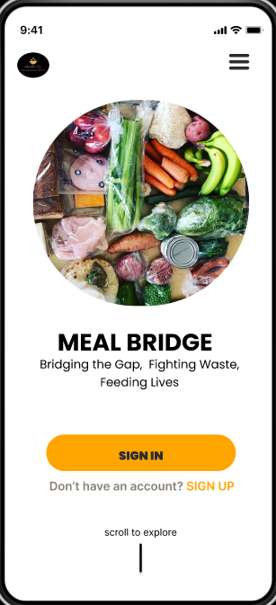
Food
Donation App
MEAL BRIDGE
“Bridging the gap, Fighting waste, Feeding Lives”

Slide 2
GROUP MEMBERS
NAMES | MATRICULE
NDIKINTUM CARL NFON | FE20A073
NYENTY EYONG ARREHQUETTE | FE20A094
OBASIARREY M’ONEKE MARY ARREY-NJOK | FE20A095
OROCKTAKANG AGBORBEJA NTANGNTANG | FE20A097
SALLE-NJUME MERYL EPOTE | FE20A102

Slide 3

INTRODUCTION
The food donation app aims to address the pressing issues of hunger, food waste, and inequality within communities. By connecting individuals, businesses, and organizations, its primary goal is to feed lives, bridge the gap, and fight waste.

Slide 4
Designing with Figma
Figma is a design tool that can be used to create food donation platforms. Figma is a web-based application, so it can be accessed from anywhere. Figma also has a number of features that make it ideal for designing food donation platforms, such as:
Collaboration: Figma allows multiple people to work on the same design at the same time.
Prototyping: Figma can be used to create prototypes of food donation platforms. This allows users to test the platform and provide feedback before it is launched.
Deployment: Figma can be used to deploy food donation platforms to the web.

Slide 5
THE PROCESS
1
The first thing we did was create sketches, throwing all our ideas onto paper. As you know, the pen and the paper are the great design tools in the early stages of the design process. This gave us a bird’s eye view of the whole project and more inspiration and ideas on how the application is to turn out.

Slide 6
THE PROCESS
2
We created low fidelity wireframes, then we thought to ourselves “Who will use this project ? . ” We quickly retreated and created a survey targeting the potential users. We sent out the survey and got the feedback that opened our eyes. After receiving the feedback, we went back to our sketches with a fresh brain full of ideas.

Slide 7
THE PROCESS
3
With our ideas well defined, we created a user flow, then modified the low fidelity prototype we had earlier based on the feedback we received from the survey. We created the design system and designed the high fidelity prototype adding visual design, illustration and content that best resonated the user.

Slide 8
THE PROCESS
4
We shared the final design with a few group of friends, got them to test it and got their feedback. This helped us to understand how the application works from the users perspective.
We believe and application is never complete because the users always have new needs to be met. In this light, here is our work in progress

Slide 9
ONBOARDING SCREEN
We need our Users to Understand the aim of the application, and give them the positive first impression

Slide 10
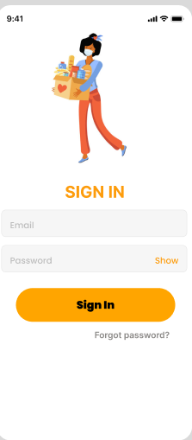
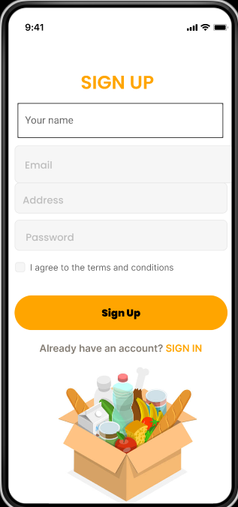
PROFILE SETUP & LOGIN
The Sign In and Sign Up
pages urge users to own an account before they are granted access to the application.

Slide 11
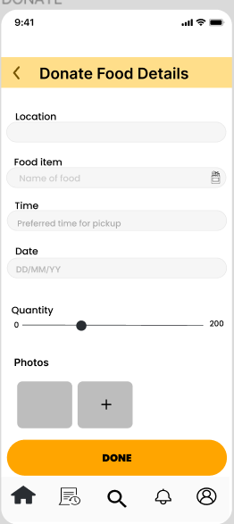
DONATE
We made use of forms to collect the food donation details. As such, it is easier to collect and store the details and further display them on the feed.

Slide 12
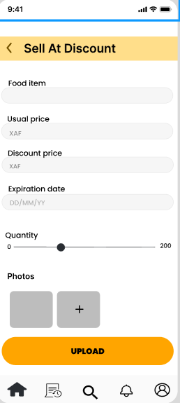
SELL AT DISCOUNT
We equally made use of forms here, for users who decide to sell their food instead of donate.

Slide 13
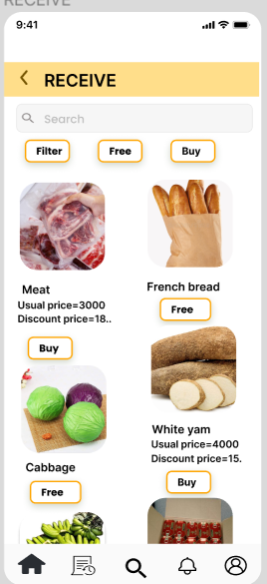
RECEIVE
On the receive or search food page, a feed displays all the food items available for donation or for sale as were uploaded by the donor or seller.

Slide 14
OTHER INTERACTIONS
Notification
History
User Profile

Slide 15
COLOR CHOICE
#FFA500
#FFB800
#BDBDBD
#F##FFFFFFF
Orange is a warm color that is often associated with happiness,. These are all positive emotions that can be associated with food donation, as it is an act of kindness and generosity.
This a powerful color that can be used to create a sense of urgency or importance. This can be helpful in encouraging people to donate food.
White is a neutral color that can be used to create a sense of balance and harmony. It can also be used to make text and images more readable.
Orange is a very bright color, so using a secondary color that is darker or more muted can help to create contrast and make the design more visually appealing.

Slide 16
CONCLUSION
Designing a food donation platform that is user-friendly can be challenging. By utilising a design tool like Figma we were able to design and create a consistent design system, collaborate effectively with our team, and incorporate user feedback.

Slide 17
Thanks!
FOR YOUR KEEN ATTENTION

